Slide 1

Introduction to Machine Learning in R
Dr Giorgia Mori
Dr Henry Lydecker
Sydney Informatic Hub

Slide 2
Sydney Informatics Hub
SIH is a Core Research Facility of the University of Sydney enabling excellence in computational and data-driven research through advanced digital infrastructure, expert data consultancy and analytics training
”
https://sydney.edu.au/sydney-informatics-hub
Notes:
We are a core research facility supporting computational and data-driven research across different discipline through a range of services and activities we offer.

Slide 3
Sydney Informatics Hub Empowering researchers with modern data & computational methods
Consultation
Grant application support
Data Science, ML, modelling & analytics
Hacky Hour
Training
Research compute platforms
Research Computing
High performance computing
Bioinformatics & genomics
Modelling & visualisation
Computing training
Statistical Consulting
1-on-1 consultancy for HDR-level and above.
Experiment and survey design.
Statistical model development and testing
Statistics training
Data Science & SWE
Consulting and project collaboration providing analysis & software development for data-driven research.
Notes:
Among the services that we offer, we provide access to research infrastructure such as high-performance computing and storage, supporting researchers by providing data analysis expertise, and building data communities with events such as hacky hours, seminars, and training events like this one.

Slide 4
Code of Conduct
We expect all attendees of our training to follow the University of Sydney’s Staff and Student Codes of Conduct, including the Bullying, harassment and discrimination prevention policy.
To foster a positive and professional learning environment, we encourage the following kinds of behaviours at all our events and platforms:
Use welcoming and inclusive language
Be respectful of different viewpoints and experiences
Gracefully accept constructive criticism
Focus on what is best for the community
Show courtesy and respect towards other community members
Our full CoC, with incident reporting guidelines, is available at https://pages.github.sydney.edu.au/informatics/sih_codeofconduct/
Notes:
In line with the University of Sydney Codes of Conduct for staff and students,

Slide 5
(Examples of) Unacceptable behaviour
Sustained disruption of talks, events or communications
Written/verbal comments which have the effect of excluding people on the basis of membership of any specific group
Causing someone to fear for their safety, such as through stalking, following, or intimidation
Violent threats or language directed against another person
The display of sexual or violent images
Unwelcome sexual attention; non-consensual or unwelcome physical contact
Insults or put downs; excessive swearing
Sexist, racist, homophobic, transphobic, ableist, or exclusionary jokes
Incitement to violence, suicide, or self-harm
Continuing to initiate interaction (including photography or recording) with someone after being asked to stop
Publication of private communication without consent
Notes:
In line with the University of Sydney Codes of Conduct for staff and students, we ask you not to engage in any of these examples of unacceptable behavior.
We’d especially like to point out the first one: “disruption of talks, communications”, since this is something we’ve had issues with in the past. Some of us (and I know I can be guilty of this) have louder voices… So while we’d definitely encourage you to speak out, we have found that if we have students who are more comfortable speaking at full volume with a helper we may ask them to switch their seat so the conversation doesn’t impede the learning of students around them. So please don’t be offended if we ask you to move – we’re really trying to make sure everyone is able to learn effectively. ..

Slide 6

Asking for Help
I need help with my computer
I need help understanding something
(which likely means others do too)

Slide 7
Plan for the workshop
Time​ | Day1-March 28th | Day2-March 30th
9:00-9:15am | Welcome | Q&A from Day 1
9:15-10:30am​ | Intro to Machine Learning Exploratory Data Analysis (EDA) - Regression | Intro to Classification and EDA
10:45-11:00am​ | Morning break​ | Morning break​
11:00am-12:30pm​ | EDA - Regression (continue) | Intro to Classification and EDA (continue)
12:30-1:30pm​ | Lunch​ | Lunch​
1:30-3:00pm​ | Intro to Tidymodels – pre-processing | Tuning hyperparameters
3:00-3:15pm​ | Afternoon break​ | Afternoon break​
3:15-4:45pm​ | Linear Models and working with workflows | Regularized logistic regression, random forest – compare models

Slide 8

How are statistics and Machine Learning related?

Slide 9


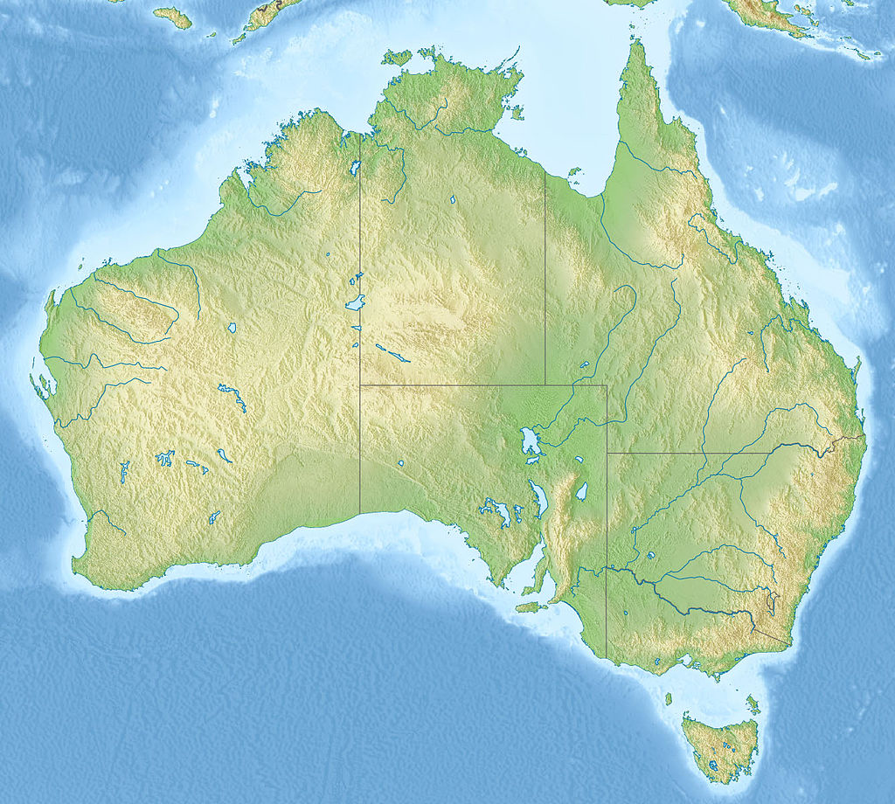

Statistics: inferring from samples

Slide 10


Machine Learning: making generalizable predictors
5 beds
4 baths
Water views
Mosman
Featured on fancy architecture website

Slide 11
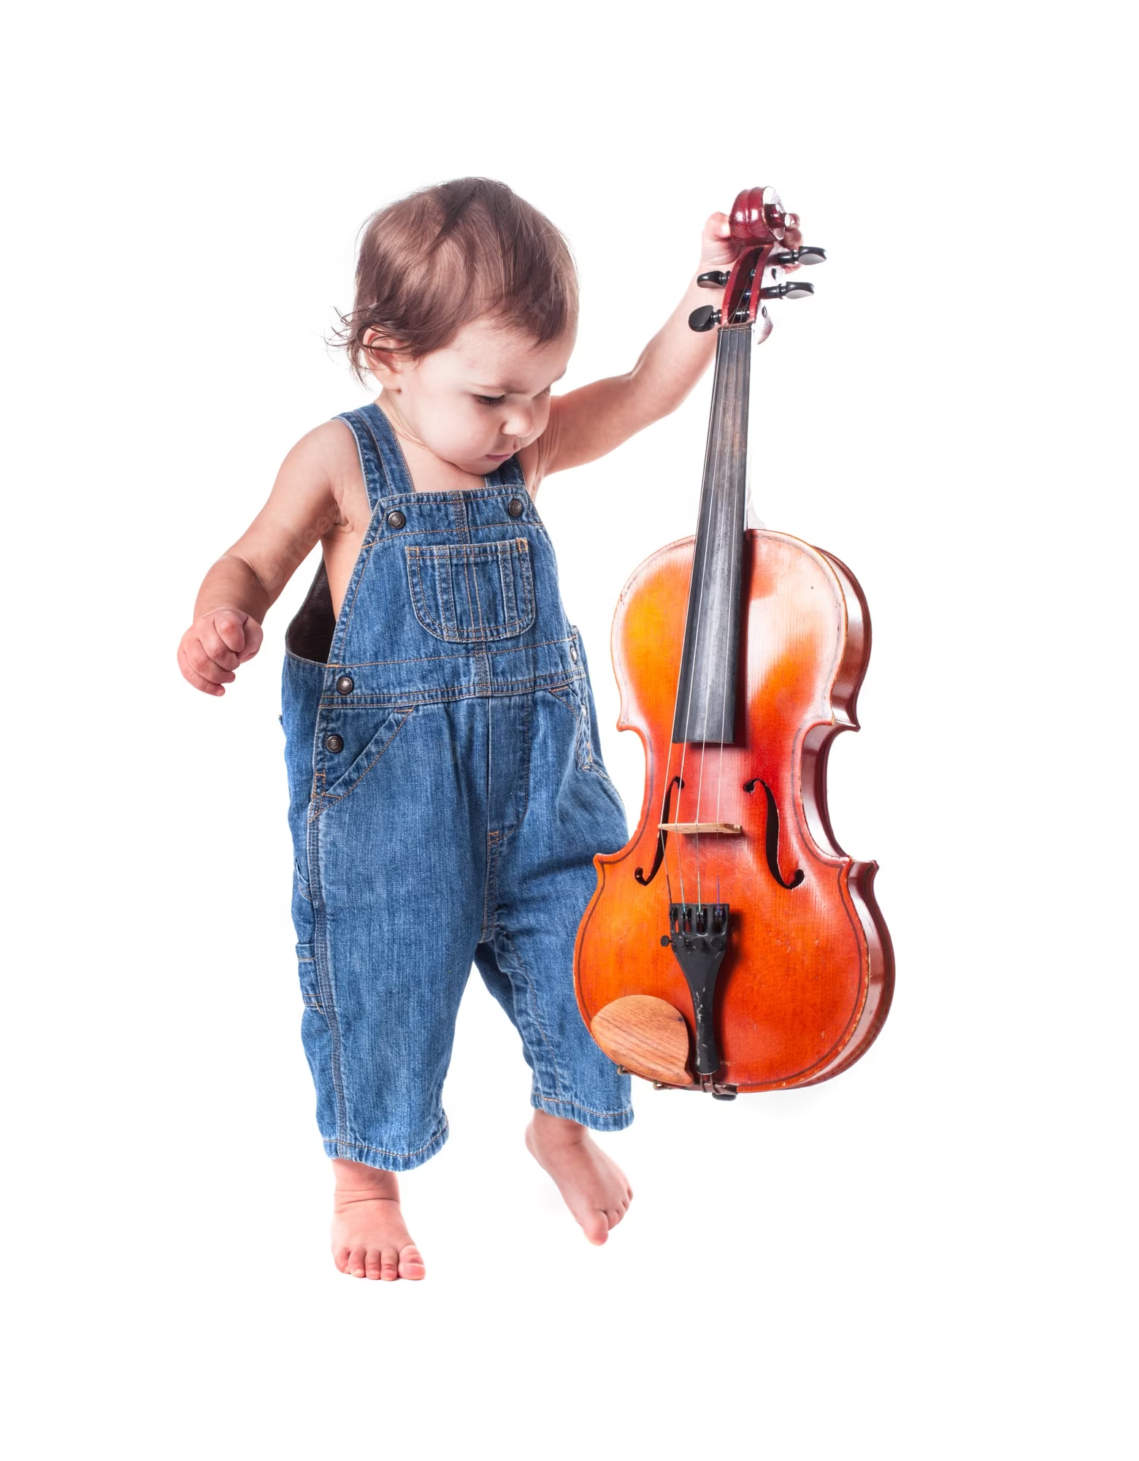
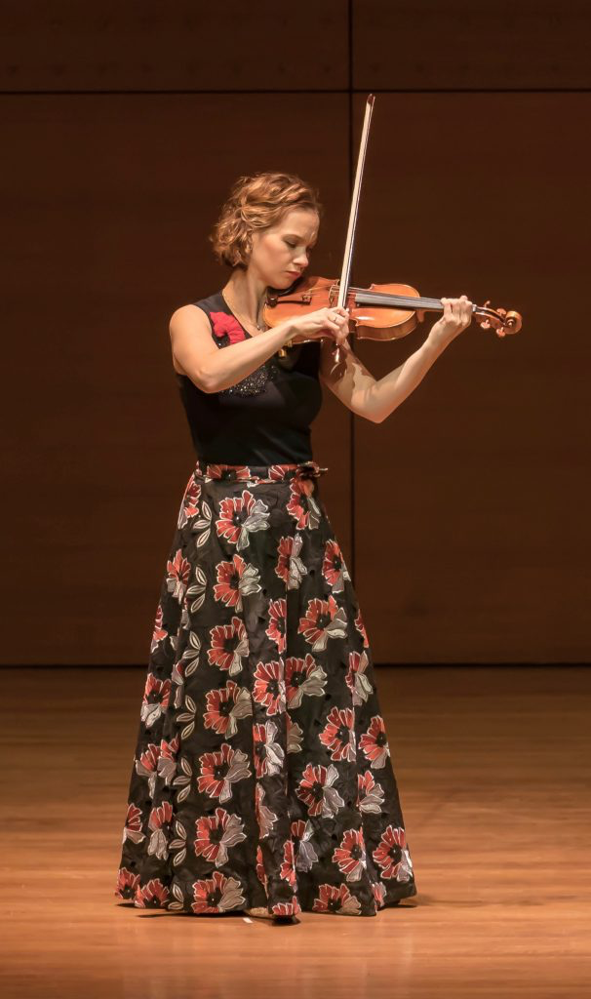
Skill comes from learning and practice

Slide 12
Terminology
Find an algorithm f(x) that most accurately predicts future values y based on a set of inputs x
Observations/data points – rows (in R)
Predictor variables – columns (in R)
Outcome - what you’re trying to predict (usually more applicable in the context of supervised learning)

Slide 13
Generalisability and overfitting
Generalisability – ability to predict well on future, unseen data (can assess this with a validation set) – good model!
Overfitting – model fits existing data very well (too well), but doesn’t generalise to new data – bad model!

Slide 14

Training and testing
Training
Testing*
Model
We want to train our model such that it can be generalizable enough to the test set, but not such that it is overfit to the training set.
*Do not touch the test set!
Images from: http://epicalsoft.blogspot.com/2019/02/azure-machine-learning-sobreajuste-y.html
Notes:
Some (silly) people have trained their algorithms on the entirety of the training AND test sets – do not do this, because otherwise it defeats the purpose of having a train/test split.

Slide 15
Statistical modeling is an extension of hypothesis testing
Explains?
Hypothesis
Reality
Matches?
Model
Data
Reject or not

Slide 16
The goal of Machine Learning is to generate accurate predictions
Old Data
Model
TRAIN
New Data
Trained Model
Improve?
Predictions

Slide 17
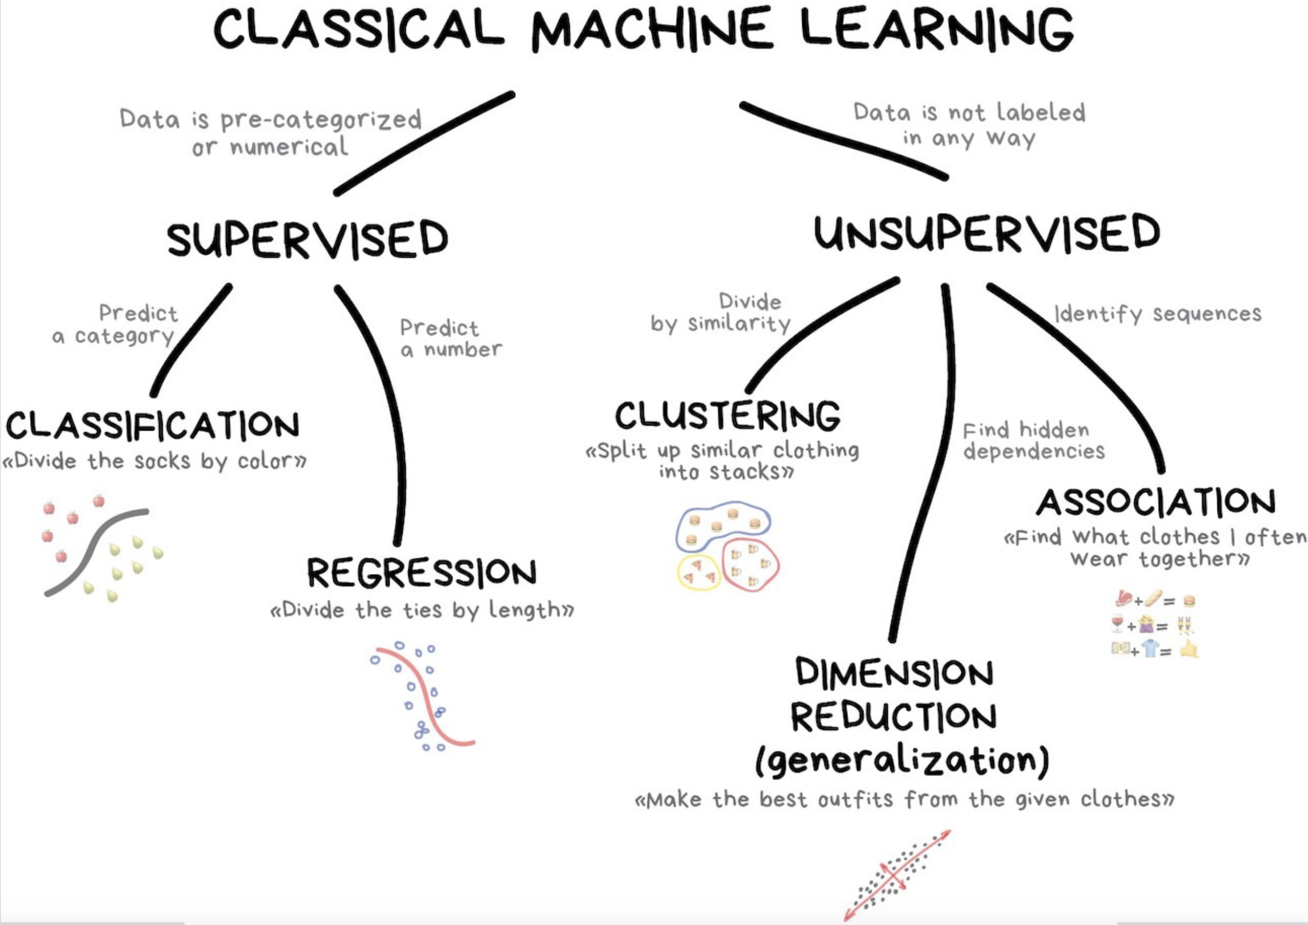
https://vas3k.com/blog/machine_learning/

Slide 18
Your turn!
Form teams within your table;
Share your backgrounds with R, data, and Machine Learning;
Choose a team name.

Slide 19
Dataset - AmesHousing
Descriptions of 2,930 houses sold in Ames, IA from 2006 to 2010, collected by the Ames Assessor’s Office.
#install.packages(“AmesHousing”)
library(AmesHousing)
ameshousing <- AmesHousing::make_ames()

Slide 20
Meet the data: Ames housing
Data set of housing data from Ames, Iowa, collected from 2006 – 2010.
Population of ~58,000 (2010)
Data includes many different physical measurements or descriptions of properties.
Assembled for an end of semester regression project by Dean De Cock at Truman University.
Popularized by a Kaggle competition predicting housing prices

Slide 21
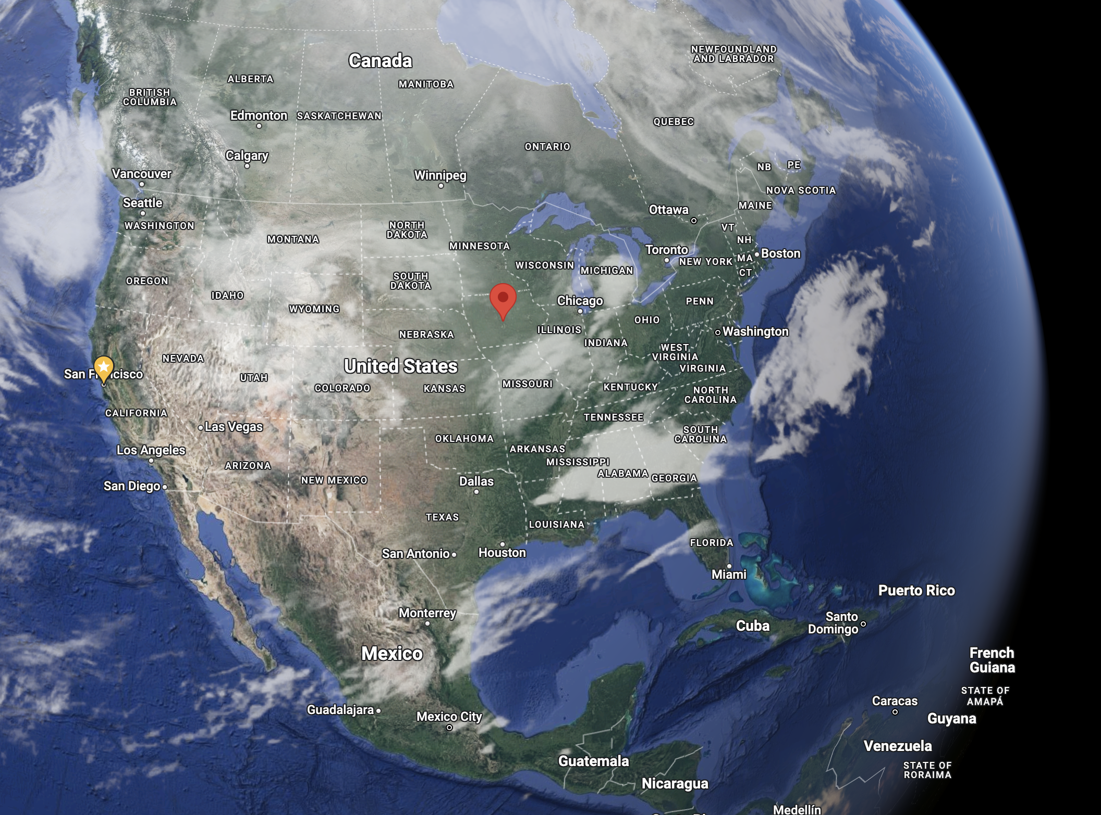

Slide 22
Exploratory Data Analysis (EDA)
Notes:
Follow website, introduce concept of outcome and features/predictors

Slide 23
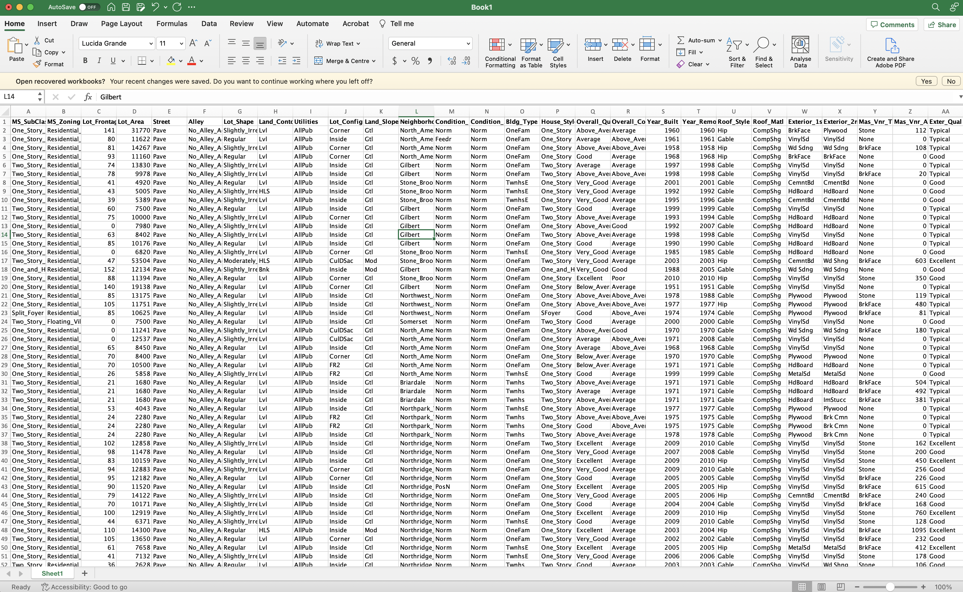
Exploring Our Data

Slide 24
Tidymodels
Notes:
Follow website and slides

Slide 25
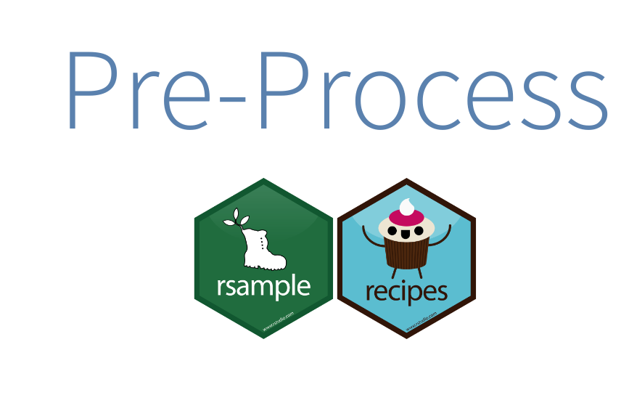

Your data budget - Data splitting
For machine learning, we typically split data into training and test sets:
The training set is used to estimate model parameters.
The test set is used to find an independent assessment of model performance.

Slide 26
Your data budget - Data spending
Spending too much data in training prevents us from computing a good assessment of predictive performance;
Spending too much data in testing prevents us from computing a good estimate of model parameters.
Some commonly used cut-offs include:
60% training / 40% testing
70% training / 30% testing
80% training / 20% testing

Slide 27
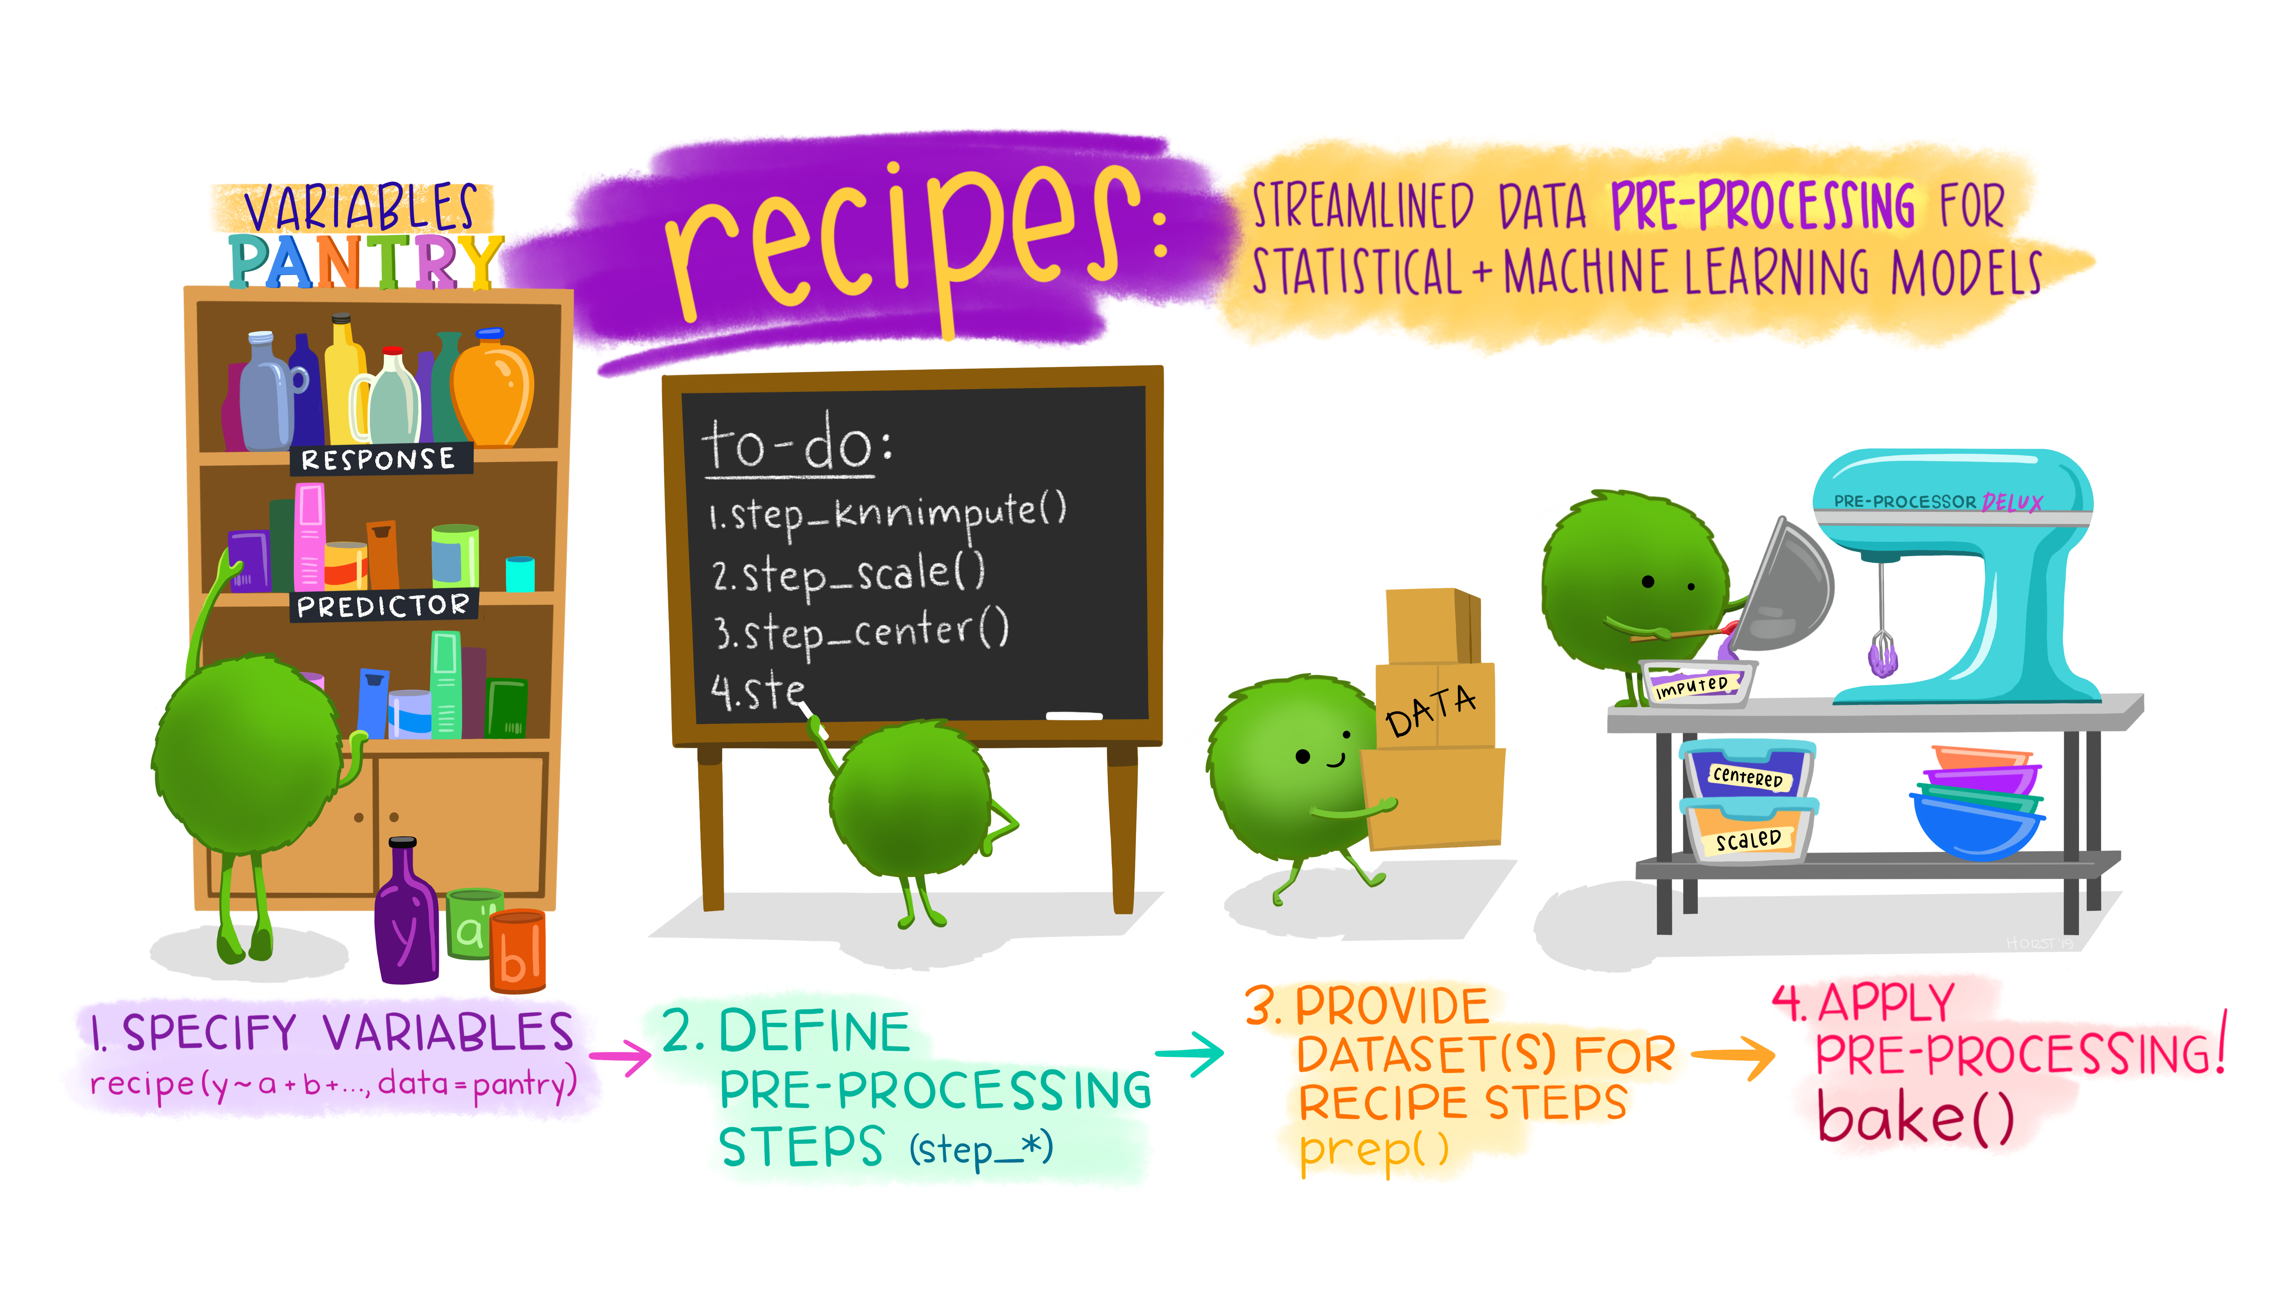
Prepare your data for modeling
Notes:
First you specify a dataset and variables.
Next you add preprocessing steps.
Then you prep the recipe to estimate the quantities for each step from the training data.
Finally, you can apply this prepped recipe to new data with bake.

Slide 28
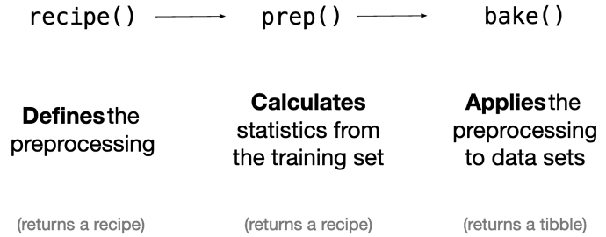
Within recipe(), the training set is used to determine the data types of each column
Within prep(), the preprocessing steps are executed using the training set
Within bake(), the training parameters are applied to the testing set.

Slide 29
Model
TRAINING DATA
fit()
recipe(), prep(), juice()
Trained Model
predict()
TESTING DATA
bake()
Predictions
Metrics
rmse()
rsq()
Notes:
Dangers of overfitting
What if we want to compare more models?
You just trained your model one time on the whole training set and then evaluated them on the testing set.
How can we use the training data to compare and evaluate different models?

Slide 30
Let’s make our life easier!
Notes:
How do we fit our resamples now and evaluate our model?

Slide 31
Workflows
The recipe prepping and model fitting can be executed using a single call to fit() instead of prep()-juice()-fit();
The recipe baking and model predictions are handled with a single call to predict() instead of bake()-predict().

Slide 32
Model
Within fit(), the training data are used for all estimation operations (from the recipe that is part of the workflow())
TRAINING DATA
fit()
recipe()
Trained Model
workflow()
Within predict(), values from the training data are used to standardize the testing data.
predict()
TESTING DATA
Predictions
Metrics
rmse()
rsq()
Notes:
Dangers of overfitting
What if we want to compare more models?
You just trained your model one time on the whole training set and then evaluated them on the testing set.
How can we use the training data to compare and evaluate different models?

Slide 33
Resampling – cross-validation
Fold 1
Fold 2
Fold 3
Fold 4
Fold 5
Fold 6
Fold 7
Fold 8
Fold 9
Fold 10
Notes:
If we use 10 folds, which percent of our data will end up in the training set and which percent in the testing set for each fold?

Slide 34
Model
TRAINING DATA
fit_resamples()
recipe()
Trained Model
workflow()
last_fit()
TESTING DATA
Predictions
Metrics
collect_metrics()
collect_predictions()
Notes:
The recipe prepping and model fitting can be executed using a single call to fit() instead of prep()-juice()-fit();
The recipe baking and model predictions are handled with a single call to predict() instead of bake()-predict();

Slide 35
Resources to keep learning:
https://www.tidymodels.org/
https://www.tmwr.org/
http://www.feat.engineering/
https://smltar.com/

